Slide 1
Programming Fundamentals
By
Shazmeen Batool

Slide 2
Previous Lecture
Accessing Elements of Structures
Comparing Structures Variables
Initializing Structure Variable

Slide 3
Today’s Lecture
Array as a Member of Structure
Array of Structures
Nested Structures

Slide 4
Array as a Member of Structure

Slide 5
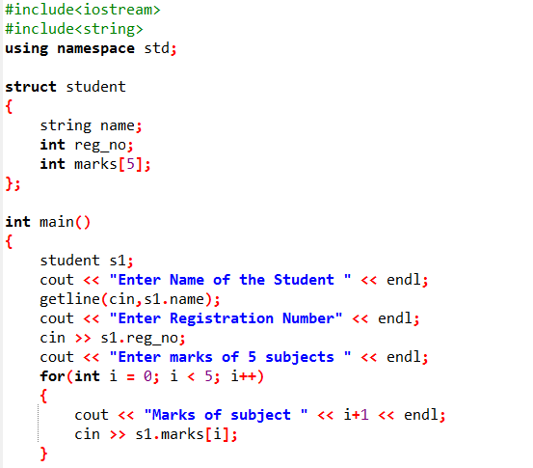
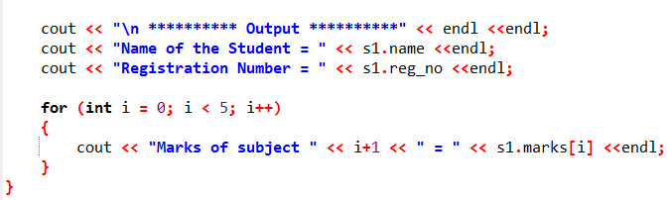

Slide 6
Array of Structure

Slide 7
Array of Structure
Array of structures can simplify some programming tasks.
An array of structures is defined like any other array.

Slide 8
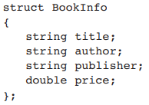
Array of Structure
An array of structures is defined like any other array.
Assume the following structure declaration exists in a program:
The following statement defines an array, bookList, that has 20 elements. Each element is a BookInfo structure.

Slide 9
Array of Structure
The following statement defines an array, bookList, that has 20 elements. Each element is a BookInfo structure.
Each element of the array may be accessed through a subscript.
For example, bookList[0] is the first structure in the array, bookList[1] is the second, and so forth.

Slide 10
Array of Structure
To access a member of any element, simply place the dot operator and member name after the subscript.
For example, the following expression refers to the title member of bookList[5] :

Slide 11
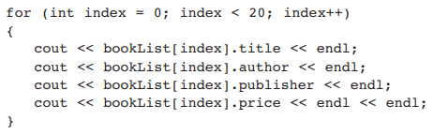
Array of Structure
The following loop steps through the array, displaying the data stored in each element:

Slide 12
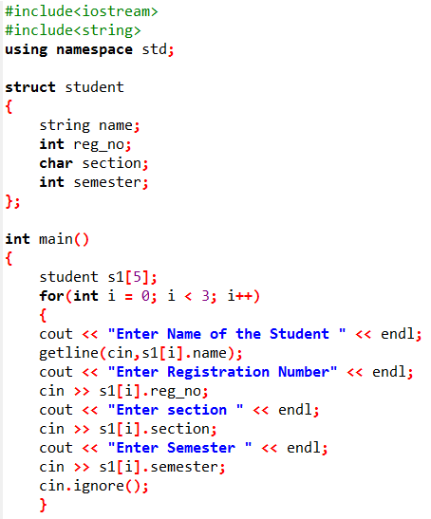
Example 1/2

Slide 13
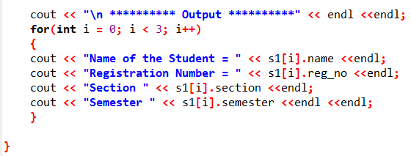
Example 2/2

Slide 14

Initializing a Structure Array
To initialize a structure array, simply provide an initialization list for one or more of the elements
As in all single-dimensional arrays, you can initialize all or part of the elements in an array of structures, as long as you do not skip elements.

Slide 15
Nested Structure

Slide 16
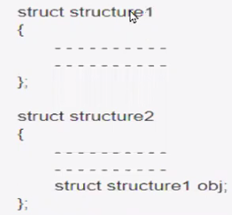
Nested Structure
When a structure contains another structure, it is called nested structure.

Slide 17
Nested Structure
For example, we have two structures named Address and Employee, we have to define Address structure before and outside Employee structure and create an object of Address structure inside Employee structure.

Slide 18
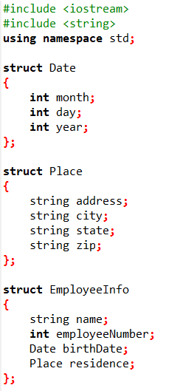
Example (1/3)

Slide 19
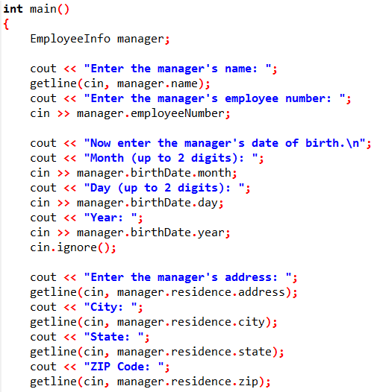
Example (2/3)

Slide 20
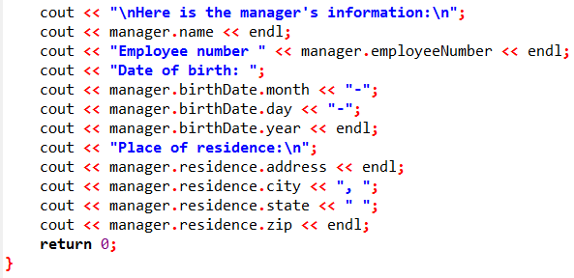
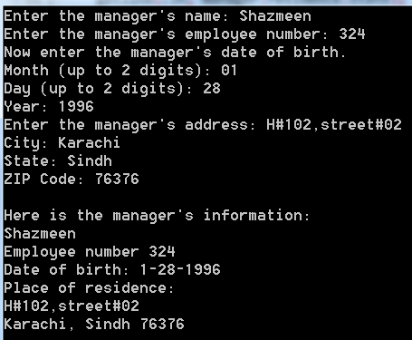
Example (3/3)

Slide 21
Next Lecture
Structures and Functions
Structures and Pointers

